Slide 1
The Internet Protocol (IP) is the transmission mechanism used by the TCP/IP protocols at the network layer.
TCP/IP Protocol Suite

Slide 2
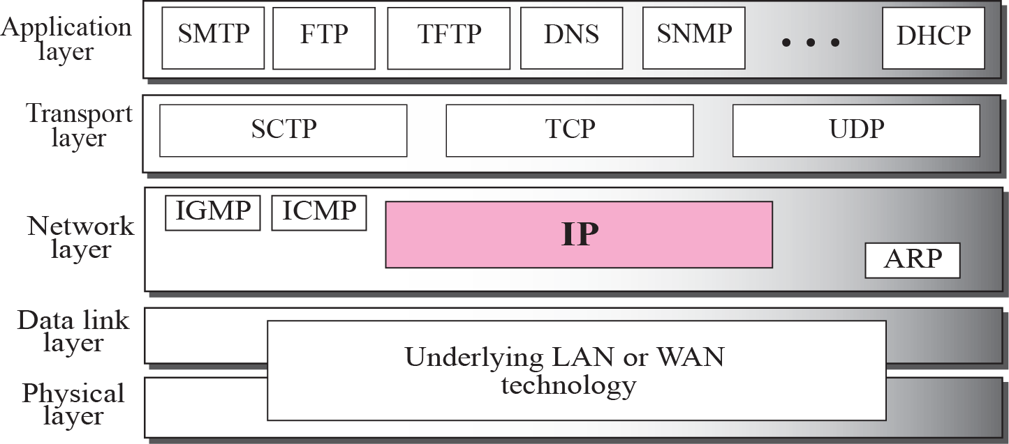
Figure 7.1 Position of IP in TCP/IP protocol suite
TCP/IP Protocol Suite
Notes:
SCTP stands for Stream Control Transmission Protocol. It is a connection- oriented protocol in computer networks which provides a full-duplex association i.e., transmitting multiple streams of data between two end points at the same time that have established a connection in network.
IGMP is a communication protocol used by hosts and adjacent routers for multicasting communication with IP networks and uses the resources efficiently to transmit the message/data packets. Multicast communication can have single or multiple senders and receivers and thus, IGMP can be used in streaming videos, gaming or web conferencing tools.

Slide 3
7-2 DATAGRAMS
Packets in the network (internet) layer are called datagrams. A datagram is a variable-length packet consisting of two parts: header and data. The header is 20 to 60 bytes in length and contains information essential to routing and delivery. It is customary in TCP/IP to show the header in 4-byte sections. A brief description of each field is in order.
TCP/IP Protocol Suite

Slide 4
Topics Discussed in the Section
Format of the datagram packet
Some examples
TCP/IP Protocol Suite

Slide 5
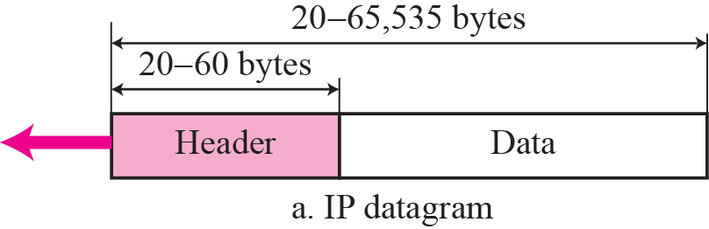
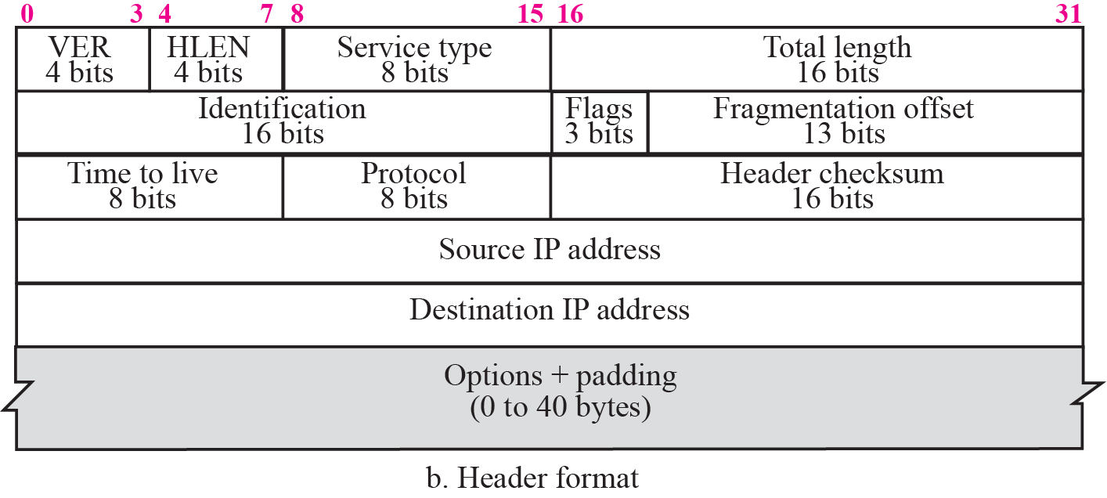
Figure 7.2 IP datagram
TCP/IP Protocol Suite
Notes:
VERSION: Version of the IP protocol (4 bits), which is 4 for IPv4
HLEN: IP header length (4 bits), which is the number of 32 bit words in the header. The minimum value for this field is 5 and the maximum is 15.
Type of service: Low Delay, High Throughput, Reliability (8 bits)
Total Length: Length of header + Data (16 bits), which has a minimum value 20 bytes and the maximum is 65,535 bytes.
Identification: Unique Packet Id for identifying the group of fragments of a single IP datagram (16 bits)
Flags: 3 flags of 1 bit each : reserved bit (must be zero), do not fragment flag, more fragments flag (same order)
Fragment Offset: Represents the number of Data Bytes ahead of the particular fragment in the particular Datagram. Specified in terms of number of 8 bytes, which has the maximum value of 65,528 bytes.
Time to live: Datagram’s lifetime (8 bits), It prevents the datagram to loop through the network by restricting the number of Hops taken by a Packet before delivering to the Destination.
Protocol: Name of the protocol to which the data is to be passed (8 bits)
Header Checksum: 16 bits header checksum for checking errors in the datagram header
Source IP address: 32 bits IP address of the sender
Destination IP address: 32 bits IP address of the receiver
Option: Optional information such as source route, record route. Used by the Network administrator to check whether a path is working or not.

Slide 6

Figure 20.6 Service type or differentiated services
20.<number>
Notes:
The Type Of Service (TOS) bits are a set of four-bit flags in the IP header.

Slide 7

Table 20.1 Types of service
20.<number>

Slide 8

Note
The total length field defines the total length of the datagram including the header.
TCP/IP Protocol Suite

Slide 9
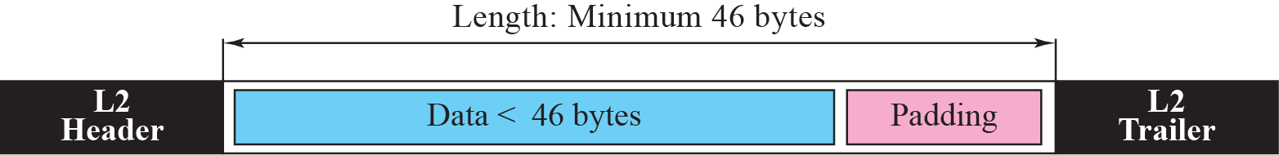
Figure 7.4 Encapsulation of a small datagram in an Ethernet frame
TCP/IP Protocol Suite
Notes:
The Padding field is used when encryption algorithms require it.

Slide 10
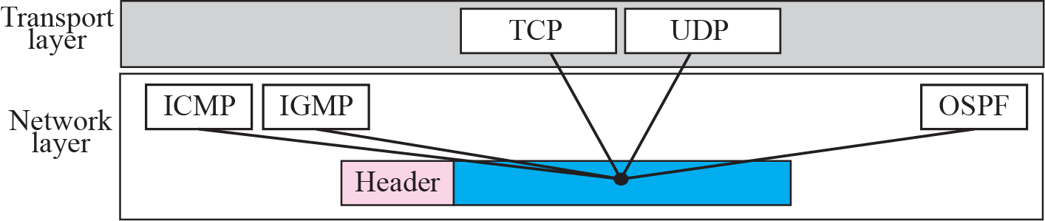
Figure 7.5 Multiplexing
TCP/IP Protocol Suite

Slide 11
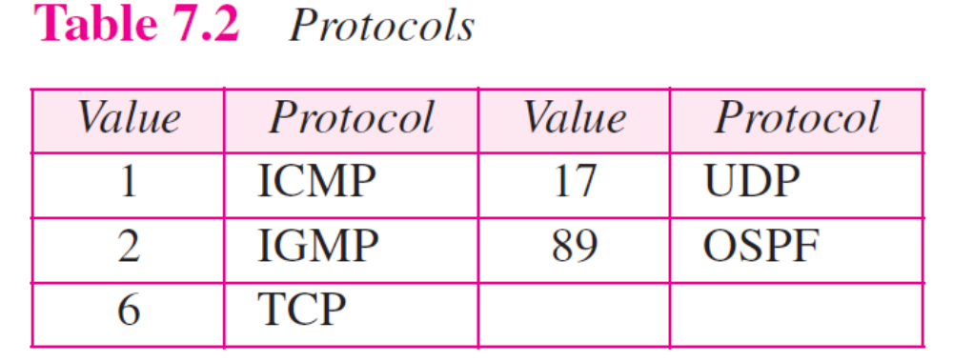
TCP/IP Protocol Suite

Slide 12
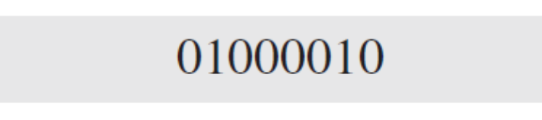
Example 7.1
An IP packet has arrived with the first 8 bits as shown:
The receiver discards the packet. Why?
TCP/IP Protocol Suite

Slide 13
Example 7.1
An IP packet has arrived with the first 8 bits as shown:
The receiver discards the packet. Why?
Solution
There is an error in this packet. The 4 left-most bits (0100) show the version, which is correct. The next 4 bits (0010) show the wrong header length (2 × 4 = 8). The minimum number of bytes in the header must be 20. The packet has been corrupted in transmission.
TCP/IP Protocol Suite

Slide 14
Example 7.2
In an IP packet, the value of HLEN is 1000 in binary. How many bytes of options are being carried by this packet?
TCP/IP Protocol Suite

Slide 15
Example 7.2
In an IP packet, the value of HLEN is 1000 in binary. How many bytes of options are being carried by this packet?
Solution
The HLEN value is 8, which means the total number of bytes in the header is 8 × 4 or 32 bytes. The first 20 bytes are the base header, the next 12 bytes are the options.
TCP/IP Protocol Suite

Slide 16
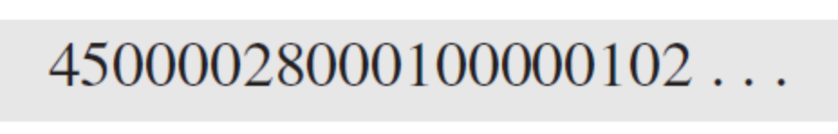
Example 7.4
An IP packet has arrived with the first few hexadecimal digits as shown below:
How many hops can this packet travel before being dropped? The data belong to what upper layer protocol?
(see Table 7.2)
TCP/IP Protocol Suite

Slide 17
Solution
To find the time-to-live field, we skip 8 bytes (16 hexadecimal digits). The time-to-live field is the ninth byte, which is 01. This means the packet can travel only one hop. The protocol field is the next byte (02), which means that the upper layer protocol is IGMP (see Table 7.2)
TCP/IP Protocol Suite

Slide 18
7-3 FRAGMENTATION
A datagram can travel through different networks. Each router decapsulates the IP datagram from the frame it receives, processes it, and then encapsulates it in another frame. The format and size of the received frame depend on the protocol used by the physical network through which the frame has just traveled. The format and size of the sent frame depend on the protocol used by the physical network through which the frame is going to travel.
TCP/IP Protocol Suite
Notes:
Fragmentation is an important function of network layer. It is technique in which gateways break up or divide larger packets into smaller ones called fragments.

Slide 19
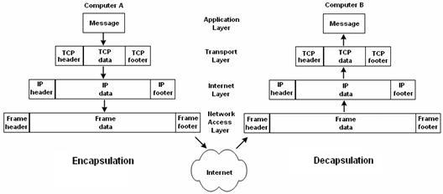
TCP/IP Protocol Suite

Slide 20
Topics Discussed in the Section
Maximum Transfer Unit (MTU)
Fields Related to Fragmentation
TCP/IP Protocol Suite

Slide 21

Figure 7.6 MTU
TCP/IP Protocol Suite

Slide 22

Table 20.5 MTUs for some networks
20.<number>

Slide 23
Note
Only data in a datagram is fragmented.
TCP/IP Protocol Suite

Slide 24

Figure 7.7 Flags field
TCP/IP Protocol Suite

Slide 25
Fragmentation is a technique implemented on a datagram at the network layer if the size of the datagram is larger than the size of the datagram that the corresponding network can forward. This technique involves the division of the large size datagram into smaller fragments.
TCP/IP Protocol Suite

Slide 26
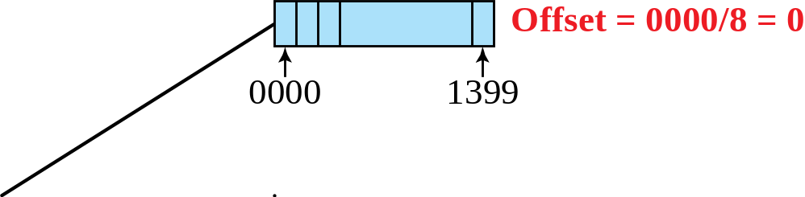
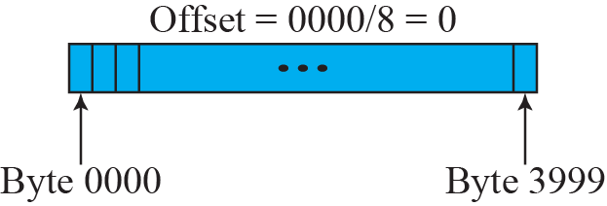
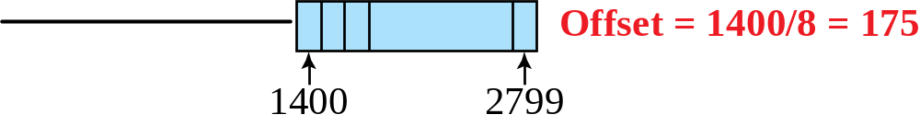
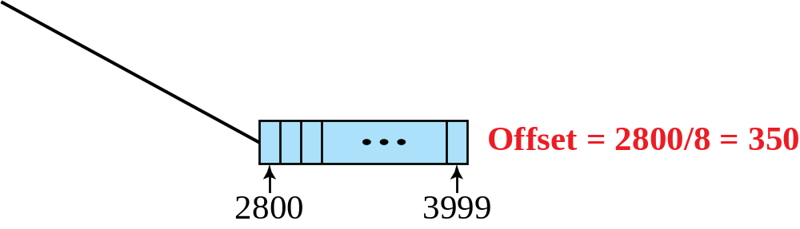
Figure 7.8 Fragmentation example
TCP/IP Protocol Suite

Slide 27
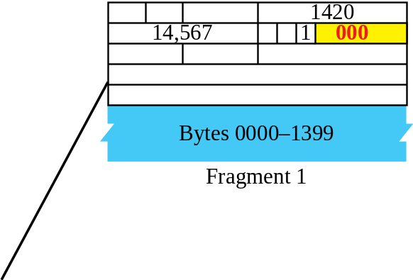
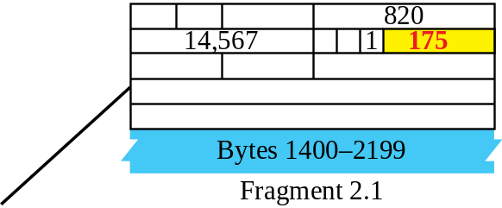
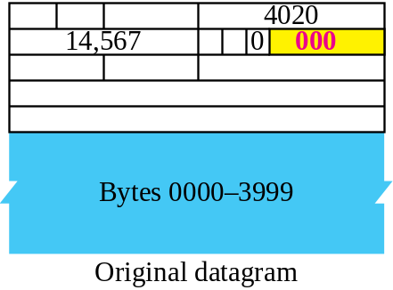
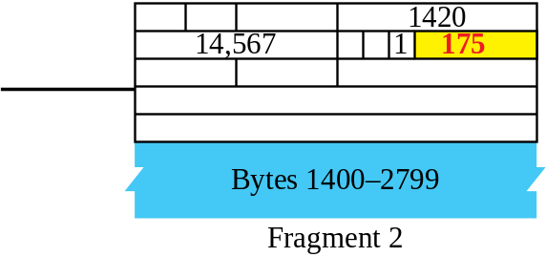
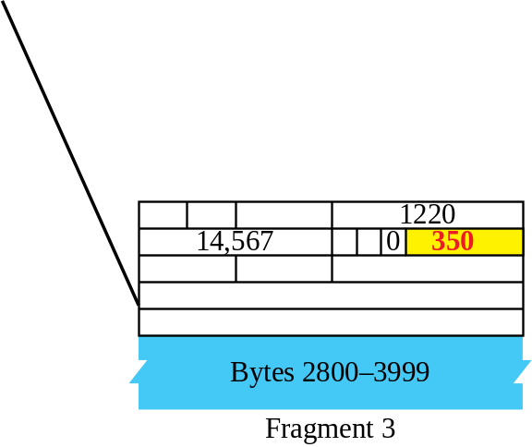
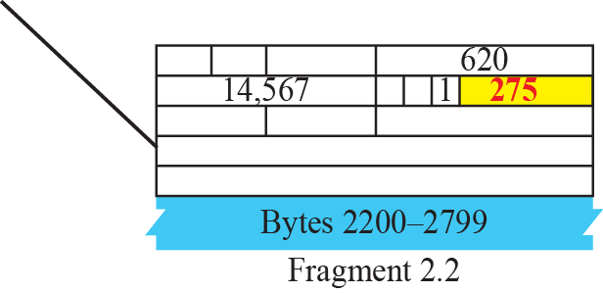
Figure 7.9 Detailed fragmentation example
TCP/IP Protocol Suite

Slide 28
Example 7.5
A packet has arrived with an M bit value of 0. Is this the first fragment, the last fragment, or a middle fragment? Do we know if the packet was fragmented?
TCP/IP Protocol Suite
Notes:
Solution
If the M bit is 0, it means that there are no more fragments; the fragment is the last one. However, we cannot say if the original packet was fragmented or not. A nonfragmented packet is considered the last fragment.

Slide 29
Example 7.6
A packet has arrived with an M bit value of 1. Is this the first fragment, the last fragment, or a middle fragment? Do we know if the packet was fragmented?
TCP/IP Protocol Suite
Notes:
Solution
If the M bit is 1, it means that there is at least one more fragment. This fragment can be the first one or a middle one, but not the last one. We don’t know if it is the first one or a middle one; we need more information (the value of the fragmentation offset). See also the next example.

Slide 30
Example 7.7
A packet has arrived with an M bit value of 1 and a fragmentation offset value of zero. Is this the first fragment, the last fragment, or a middle fragment?
TCP/IP Protocol Suite
Notes:
Solution
Because the M bit is 1, it is either the first fragment or a middle one. Because the offset value is 0, it is the first fragment.

Slide 31
Example 7.8
A packet has arrived in which the offset value is 100. What is the number of the first byte? Do we know the number of the last byte?
Solution
To find the number of the first byte, we multiply the offset value by 8. This means that the first byte number is 800. We cannot determine the number of the last byte unless we know the length of the data.
TCP/IP Protocol Suite

Slide 32
Example 7.9
A packet has arrived in which the offset value is 100, the value of HLEN is 5 and the value of the total length field is 100. What is the number of the first byte and the last byte?
TCP/IP Protocol Suite
Notes:
Solution
The first byte number is 100 × 8 = 800. The total length is 100 bytes and the header length is 20 bytes (5 × 4), which means that there are 80 bytes in this datagram. If the first byte number is 800, the last byte number must be 879.

Slide 33
7-4 OPTIONS
The header of the IP datagram is made of two parts: a fixed part and a variable part. The fixed part is 20 bytes long and was discussed in the previous section. The variable part comprises the options, which can be a maximum of 40 bytes.
Options, as the name implies, are not required for a datagram. They can be used for network testing and debugging. Although options are not a required part of the IP header, option processing is required of the IP software.
TCP/IP Protocol Suite

Slide 34
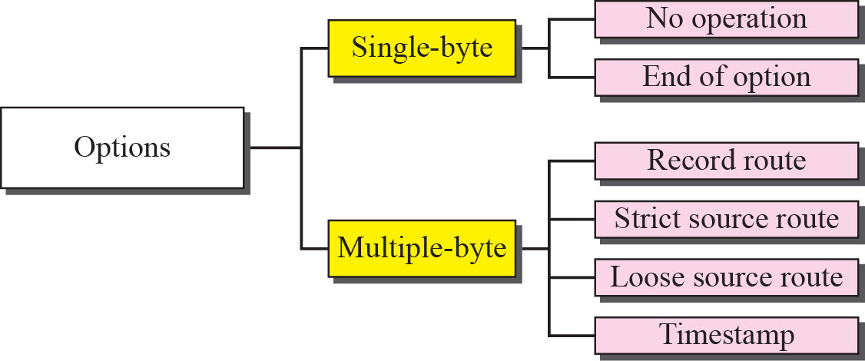
Figure 7.11 Categories of options
TCP/IP Protocol Suite

Slide 35
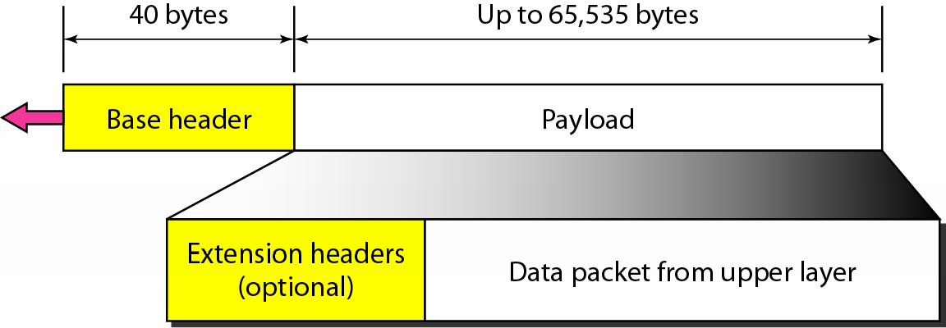
27-2 PACKET FORMAT
In IPv6 packet each packet is composed of a mandatory base header followed by the payload. The payload consists of two parts: optional extension headers and data from an upper layer. The base header occupies 40 bytes, whereas the extension headers and data from the upper layer contain up to 65,535 bytes of information.
TCP/IP Protocol Suite

Slide 36
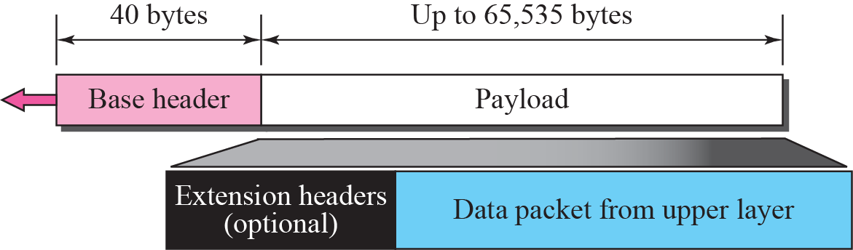
Figure 27.1 IPv6 datagram
TCP/IP Protocol Suite

Slide 37
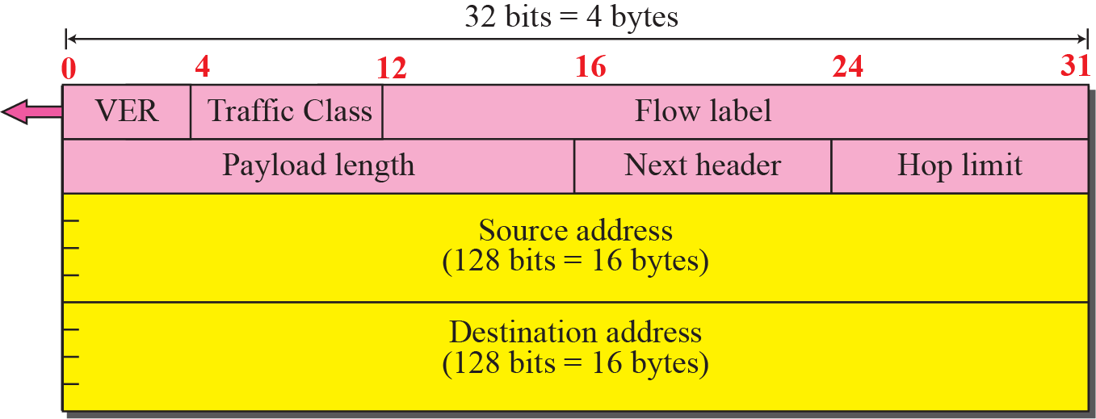
Figure 27.2 Format of the base header
TCP/IP Protocol Suite

Slide 38
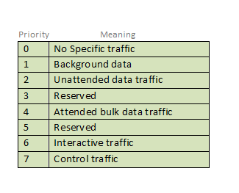
Version (4-bits): Indicates version of Internet Protocol which contains bit sequence 0110.
Traffic Class (8-bits): The Traffic Class field indicates class or priority of IPv6 packet which is similar to Service Field in IPv4 packet. It helps routers to handle the traffic based on the priority of the packet. If congestion occurs on the router then packets with the least priority will be discarded.
As of now, only 4-bits are being used (and the remaining bits are under research), in which 0 to 7 are assigned to Congestion controlled traffic and 8 to 15 are assigned to Uncontrolled traffic.
Priority assignment of Congestion controlled traffic :
TCP/IP Protocol Suite

Slide 39
Flow Label (20-bits): Flow Label field is used by a source to label the packets belonging to the same flow in order to request special handling by intermediate IPv6 routers, such as non-default quality of service or real-time service. In order to distinguish the flow, an intermediate router can use the source address, a destination address, and flow label of the packets. Between a source and destination, multiple flows may exist because many processes might be running at the same time. Routers or Host that does not support the functionality of flow label field and for default router handling, flow label field is set to 0. While setting up the flow label, the source is also supposed to specify the lifetime of the flow.
Payload Length (16-bits): It is a 16-bit (unsigned integer) field, indicates the total size of the payload which tells routers about the amount of information a particular packet contains in its payload. The payload Length field includes extension headers(if any) and an upper-layer packet. In case the length of the payload is greater than 65,535 bytes (payload up to 65,535 bytes can be indicated with 16-bits), then the payload length field will be set to 0 and the jumbo payload option is used in the Hop-by-Hop options extension header.
TCP/IP Protocol Suite

Slide 40
Next Header (8-bits): Next Header indicates the type of extension header(if present) immediately following the IPv6 header. Whereas In some cases it indicates the protocols contained within upper-layer packets, such as TCP, UDP.
Hop Limit (8-bits): Hop Limit field is the same as TTL in IPv4 packets. It indicates the maximum number of intermediate nodes IPv6 packet is allowed to travel. Its value gets decremented by one, by each node that forwards the packet and the packet is discarded if the value decrements to 0. This is used to discard the packets that are stuck in an infinite loop because of some routing error.
Source Address (128-bits): Source Address is the 128-bit IPv6 address of the original source of the packet.
Destination Address (128-bits): The destination Address field indicates the IPv6 address of the final destination(in most cases). All the intermediate nodes can use this information in order to correctly route the packet.
TCP/IP Protocol Suite

Slide 41
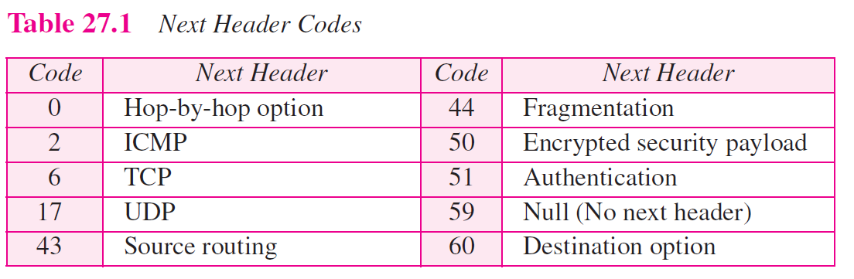
TCP/IP Protocol Suite

Slide 42
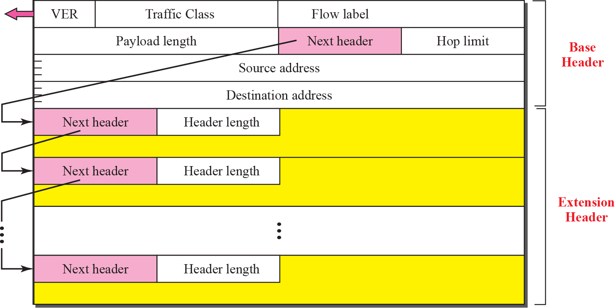
Figure 27.3 Extension header format
TCP/IP Protocol Suite

Slide 43
Extension Headers
In order to rectify the limitations of the IPv4 Option Field, Extension Headers are introduced in IP version 6. The extension header mechanism is a very important part of the IPv6 architecture. The next Header field of IPv6 fixed header points to the first Extension Header and this first extension header points to the second extension header and so on.
TCP/IP Protocol Suite

Slide 44

Figure 20.17 Extension header types
20.<number>

Slide 45
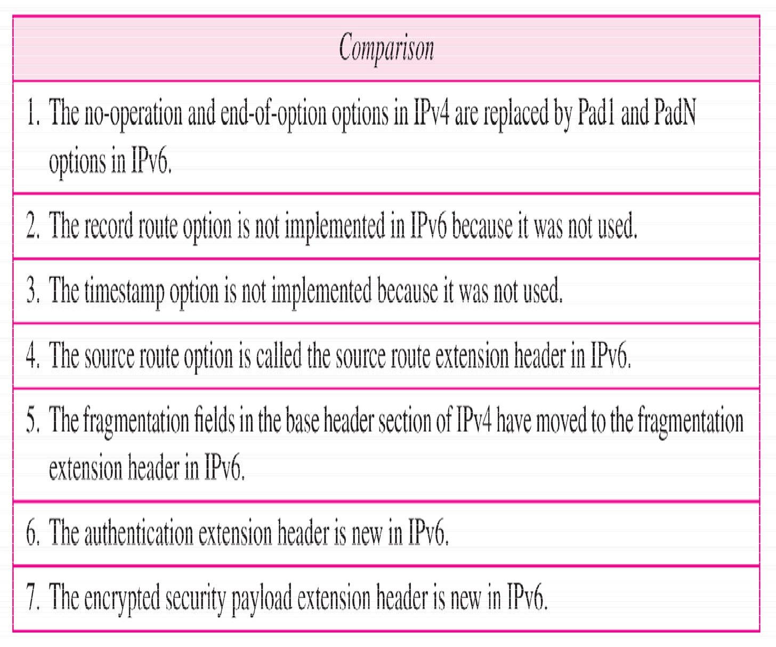
Table 20.10 Comparison between IPv4 options and IPv6 extension headers
20.<number>

Slide 46
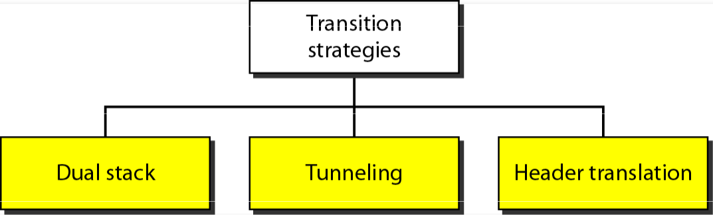
Transition from IPv4 to IPv6
.

Slide 47
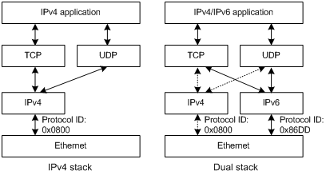
Figure 20.19 Dual stack
20.<number>

Slide 48
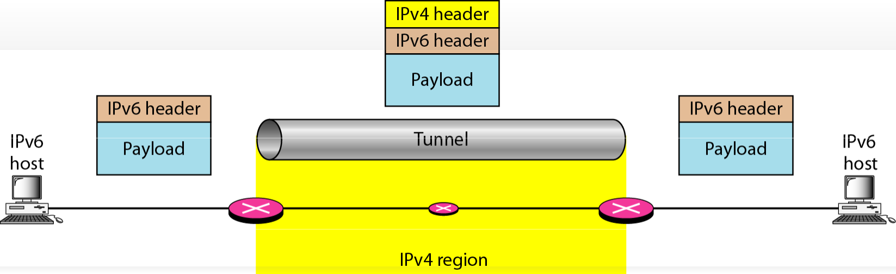
Figure 20.20 Tunneling strategy
20.50

Slide 49
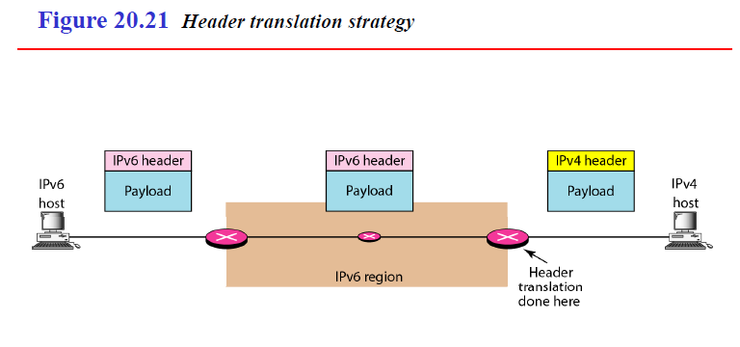
.
Notes:
NAT Protocol Translation
This is another important method of transition to IPv6 by means of a NAT-PT (Network Address Translation – Protocol Translation) enabled device. With the help of a NAT-PT device, actual can take place happens between IPv4 and IPv6 packets and vice versa.

Slide 50
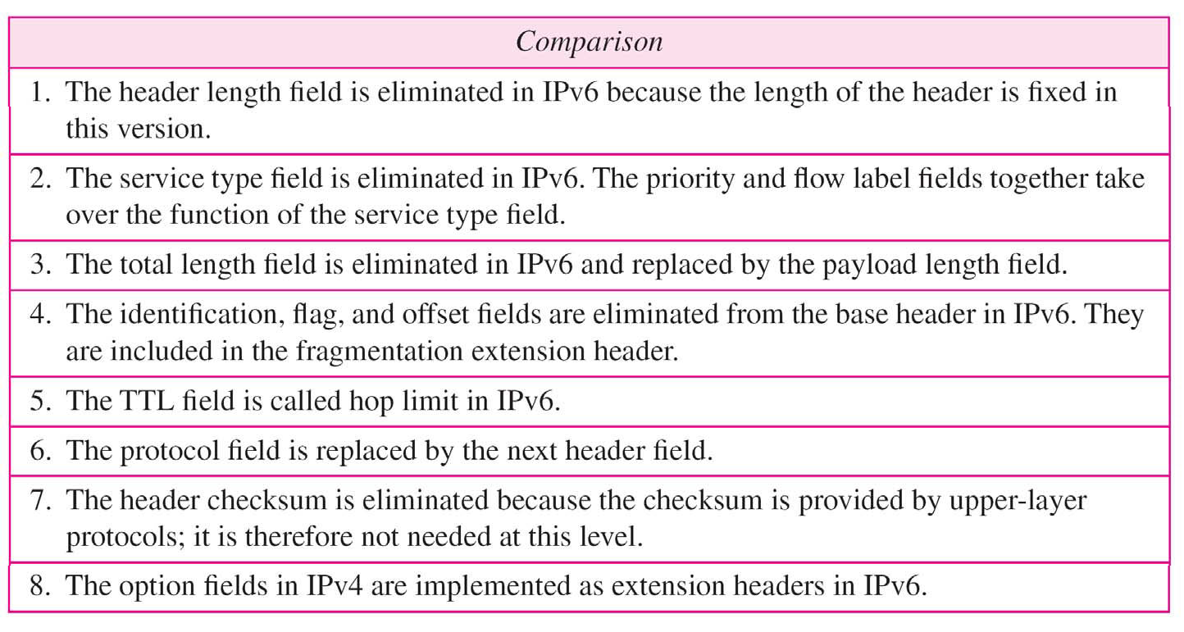
Table 20.9 Comparison between IPv4 and IPv6 packet headers
20.<number>

